Slide 1
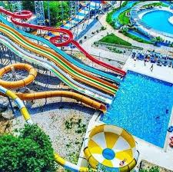

Aqua Amusement Park Marble track

Slide 2
Quick Overview
Our aim in this project is to make a fun and exciting game for kids to enjoy, using our skills to incorporate all the mechanical, electrical, and manufacturing elements to hopefully design a cohesive product that is functional first and foremost, and have cool design elements integrated in it.
The game will have the following main elements:
1- A reservoir where balls are stored and start entering the mechanism one by one
2- A sorting mechanism, where the ball goes into a separate path depending on its color
3- A shooting mechanism that detects the balls and shoots them into a specific target
4- A lifter mechanism that will take the balls into a higher elevation

Slide 3
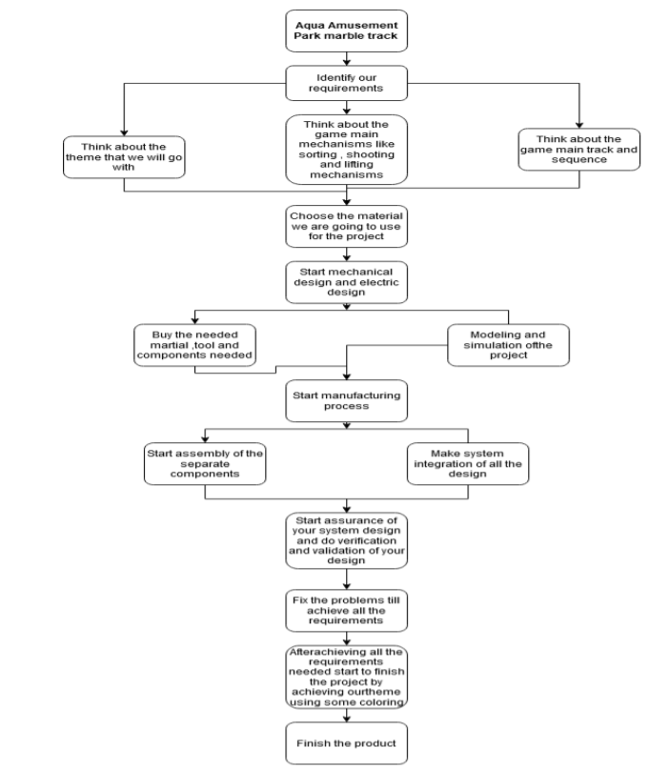
Project Plan
The following shape represents the plan and different steps that we had in mind as we were working on this project.

Slide 4
Project progression
We started the project with a theme in mind, an aqua amusement park, where our balls will go through joints, paths and mechanisms inspired by water slides.
We decided on the following flow that the ball will go through
Ball goes into sorting mechanism
Ball goes on a path depending on its color
Both paths lead to the shooter mechanism
Shooter mechanism shoots the balls towards the lifter
Balls get elevated and re-enters the sorting mechanism

Slide 5
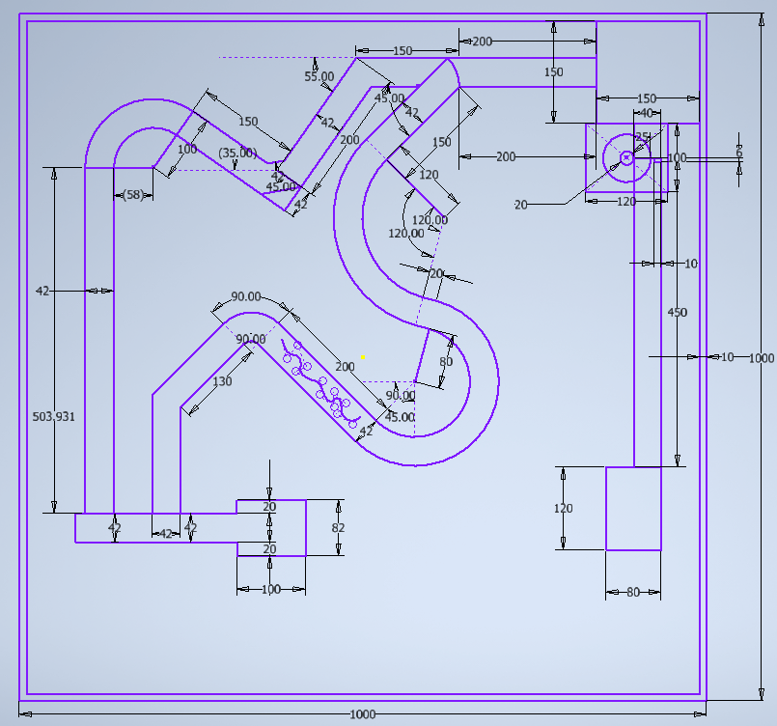
Project progression
Early sketch for the design of the track

Slide 6
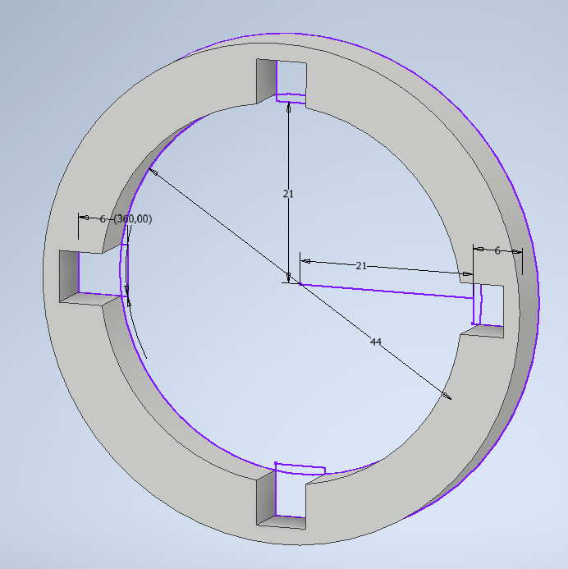
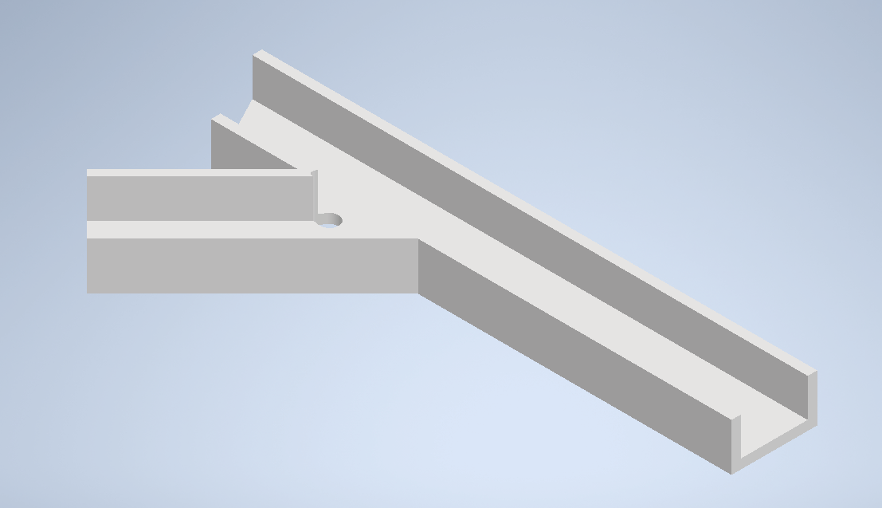
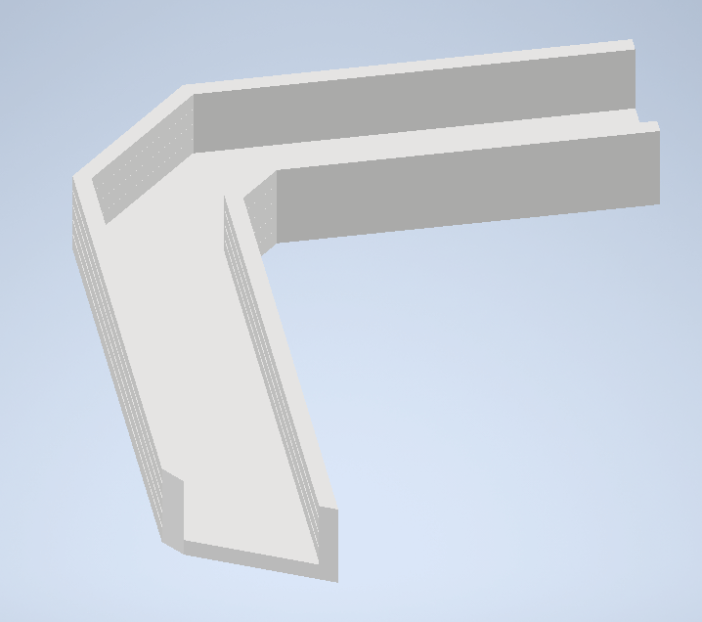
Project progression
More sketches and design elements:

Slide 7
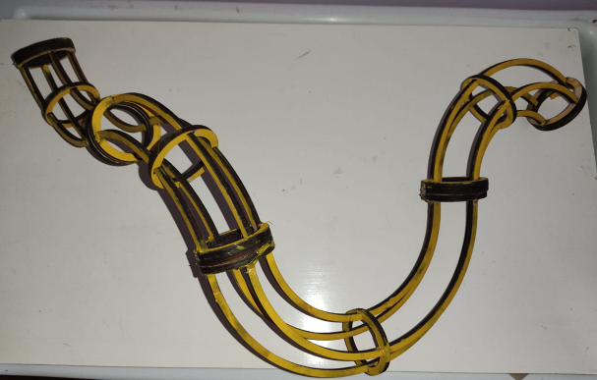
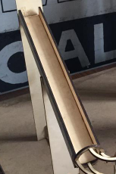
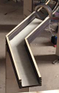
Project Manufacturing
Manufactured pieces of track :

Slide 8
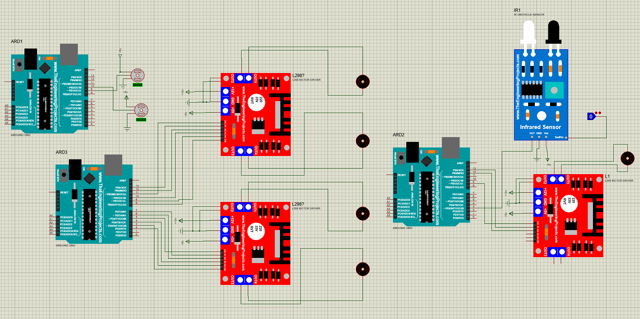
Electrical Design

Slide 9
Sorting Mechanism

Slide 10
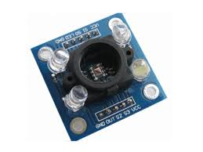
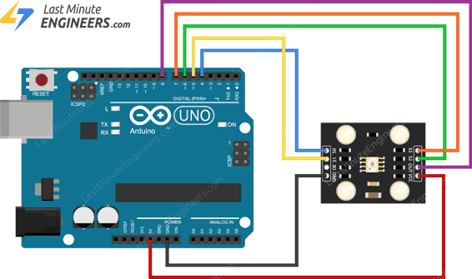
Color sensor

Slide 11
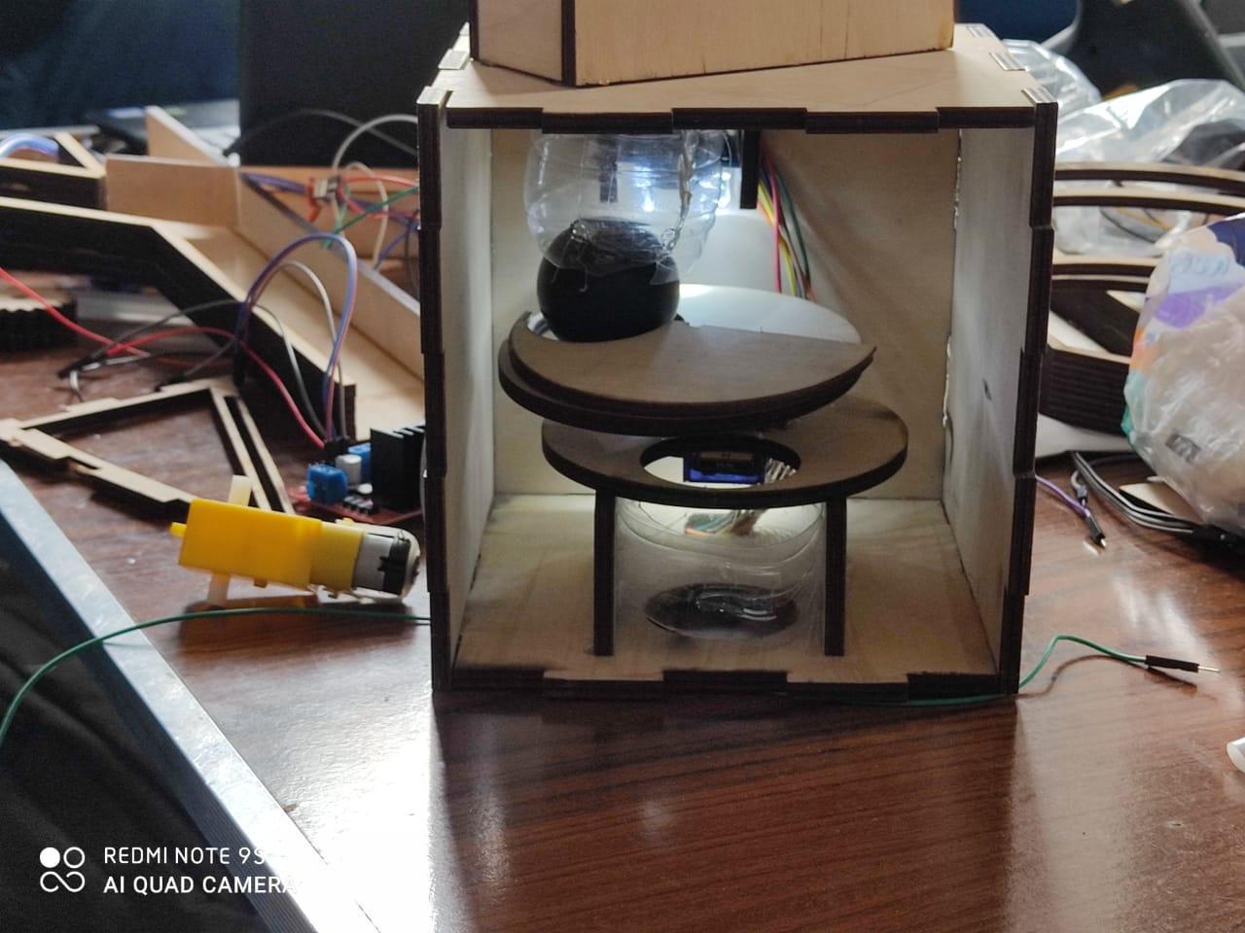
Sorting Mechanism

Slide 12
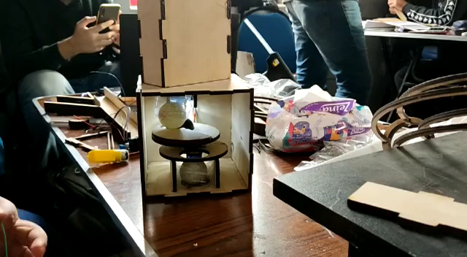
Sorting Mechanism in action

Slide 13
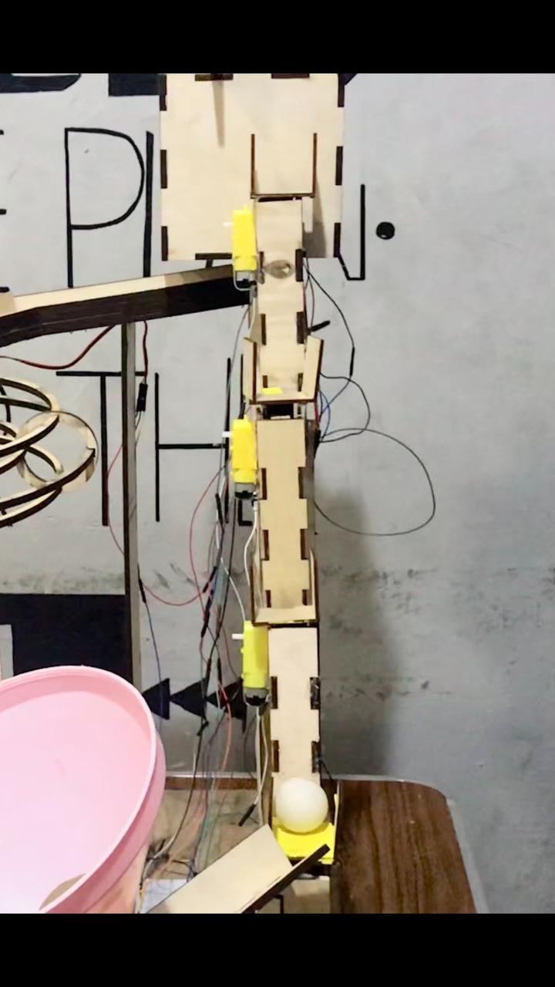
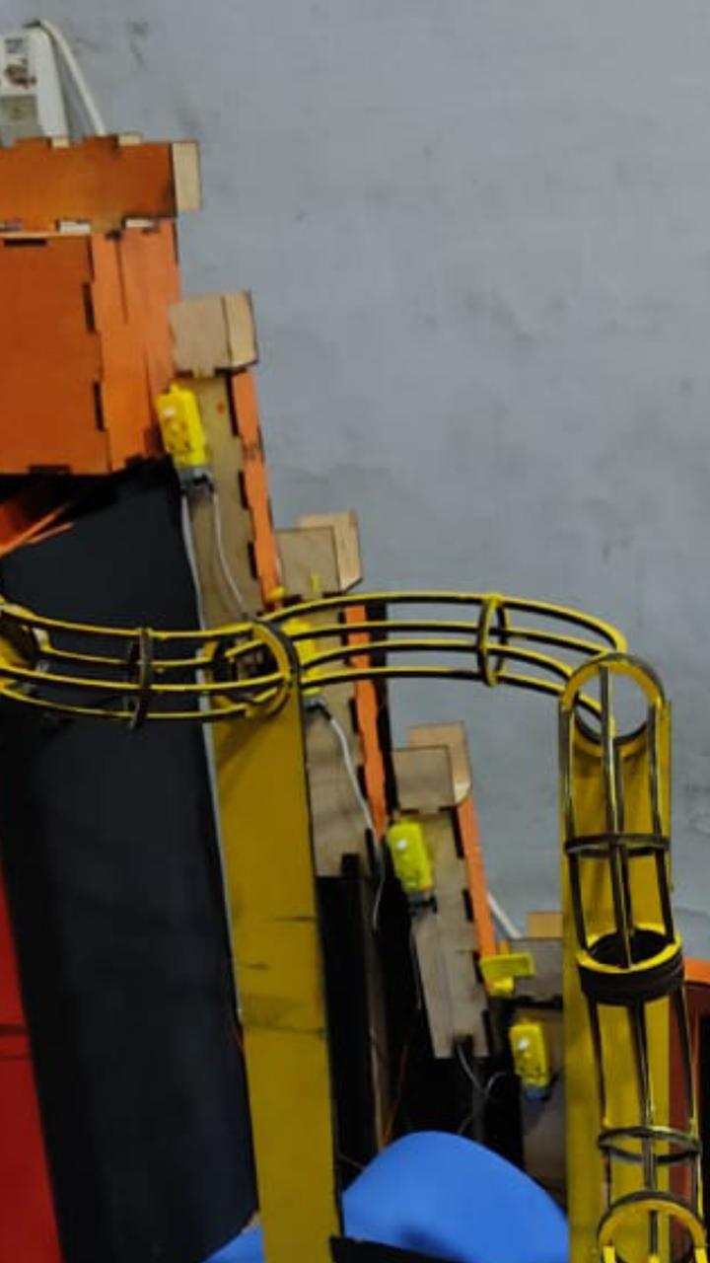
Lifting mechanism
Our lifting mechanism is made out of 4 levels of identical lifters:

Slide 14
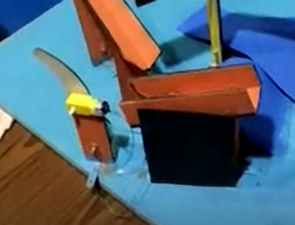
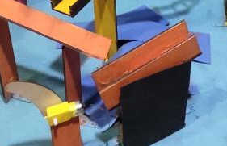
Shooting Mechanism
The Shooting Mechanism relies on an IR proximity sensor beneath the ball's landing point from the track to sense the ball and inform the motor to Shoot the ball after a slight delay

Slide 15
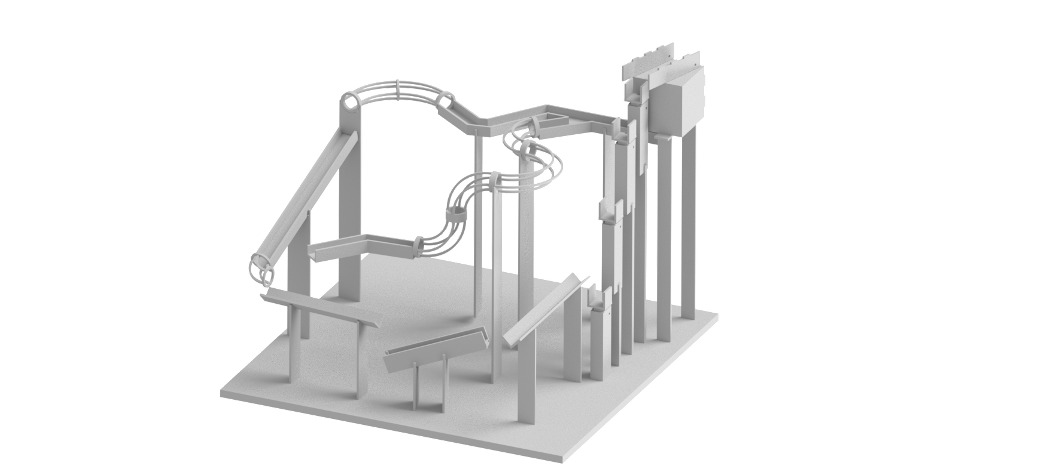
Mechanical Design

Slide 16
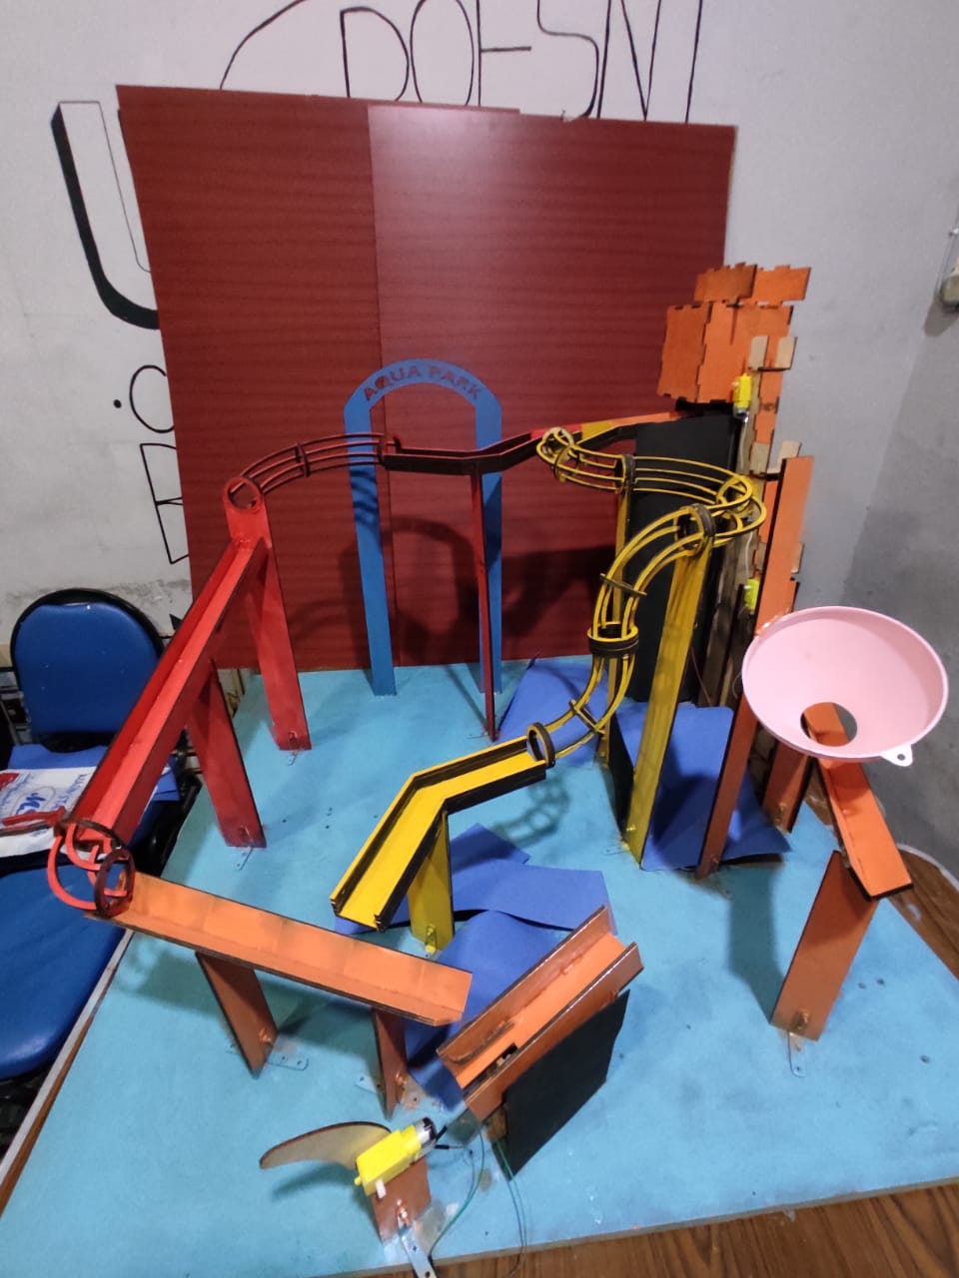
Final Product

Slide 17
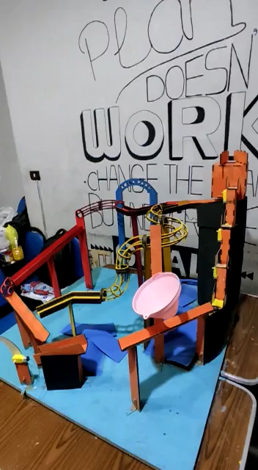
Project in action

Slide 18


Thank you

